Slide 1

ILP 2022 – W4S3 Numpy library (part 1) and imports
Matthieu DE MARI – Singapore University of Technology and Design

Slide 2
Outline (Week4, Session3 – W4S3)
Memory management and lists: aliasing, shallow and deep copies
The Numpy library (part 1): arrays, math functions, etc.
About the import procedure
Project organizing
Mini-project

Slide 3
Memory of a computer
Identifier | Memory
 | Address | Value
x1 | 140725454247872 | 10
 | … | …
The memory of a computer consists of several “boxes”, which can contain values for variables. Each “box” is identified by an integer, which corresponds to the address/ID of the “box”.

Slide 4
Memory of a computer
Identifier | Memory
 | Address | Value
x1 | 140725454247872 | 10
 | … | …
The memory of a computer consists of several “boxes”, which can contain values for variables. Each “box” is identified by an integer, which corresponds to the address/ID of the “box”.
When a variable is created:
A “box” is assigned for the variable and its value is stored in the “box”.
The variable name simply refers to the address/ID of the “box”.

Slide 5
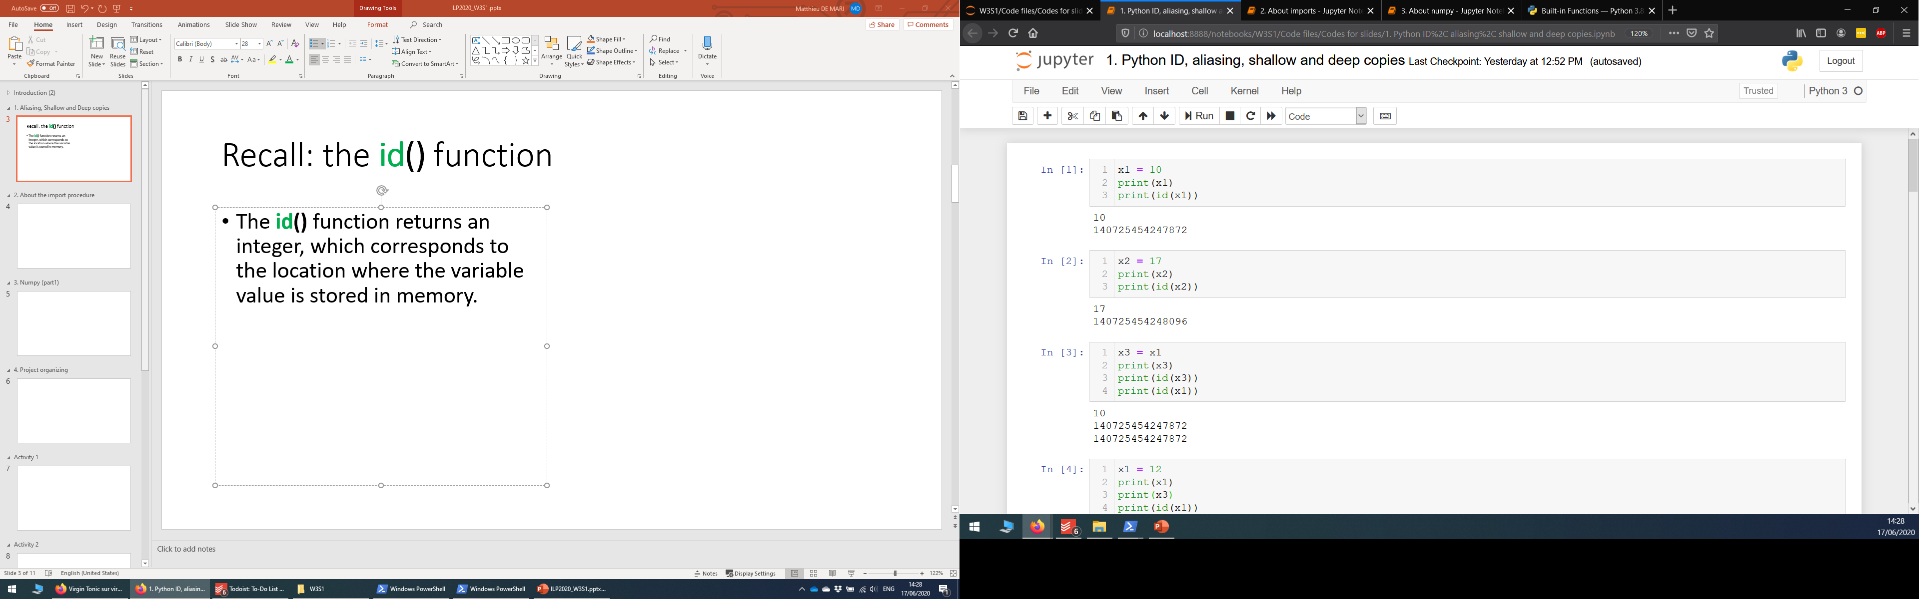
Memory of a computer
Identifier | Memory
 | Address | Value
x1 | 140725454247872 | 10
 | … | …
The memory of a computer consists of several “boxes”, which can contain values for variables. Each “box” is identified by an integer, which corresponds to the address/ID of the “box”.
When a variable is created:
A “box” is assigned for the variable and its value is stored in the “box”.
The variable name simply refers to the address/ID of the “box”.

Slide 6
Recall: the id() function
The id() function returns an integer, which corresponds to the address/ID, where the variable is stored in memory.

Slide 7
Recall: the id() function
The id() function returns an integer, which corresponds to the address/ID, where the variable is stored in memory.
Two variables names with identical values will have the same id().

Slide 8
Recall: the id() function
Identifier | Memory
 | Address | Value
x1, x3 | 140725454247872 | 10
 | … | …
The id() function returns an integer, which corresponds to the address/ID, where the variable is stored in memory.
Two variables names with identical values will have the same id().
Aliasing: Python saves memory space by having two variables names point to the same memory ID.

Slide 9
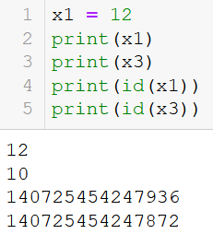
Recall: the id() function
Identifier | Memory
 | Address | Value
x3 | 140725454247872 | 10
x1 | 140725454247936 | 12
The id() function returns an integer, which corresponds to the address/ID, where the variable is stored in memory.
Two variables names with identical values will have the same id().
Aliasing: Python saves memory space by having two variables names point to the same memory ID.

Slide 10
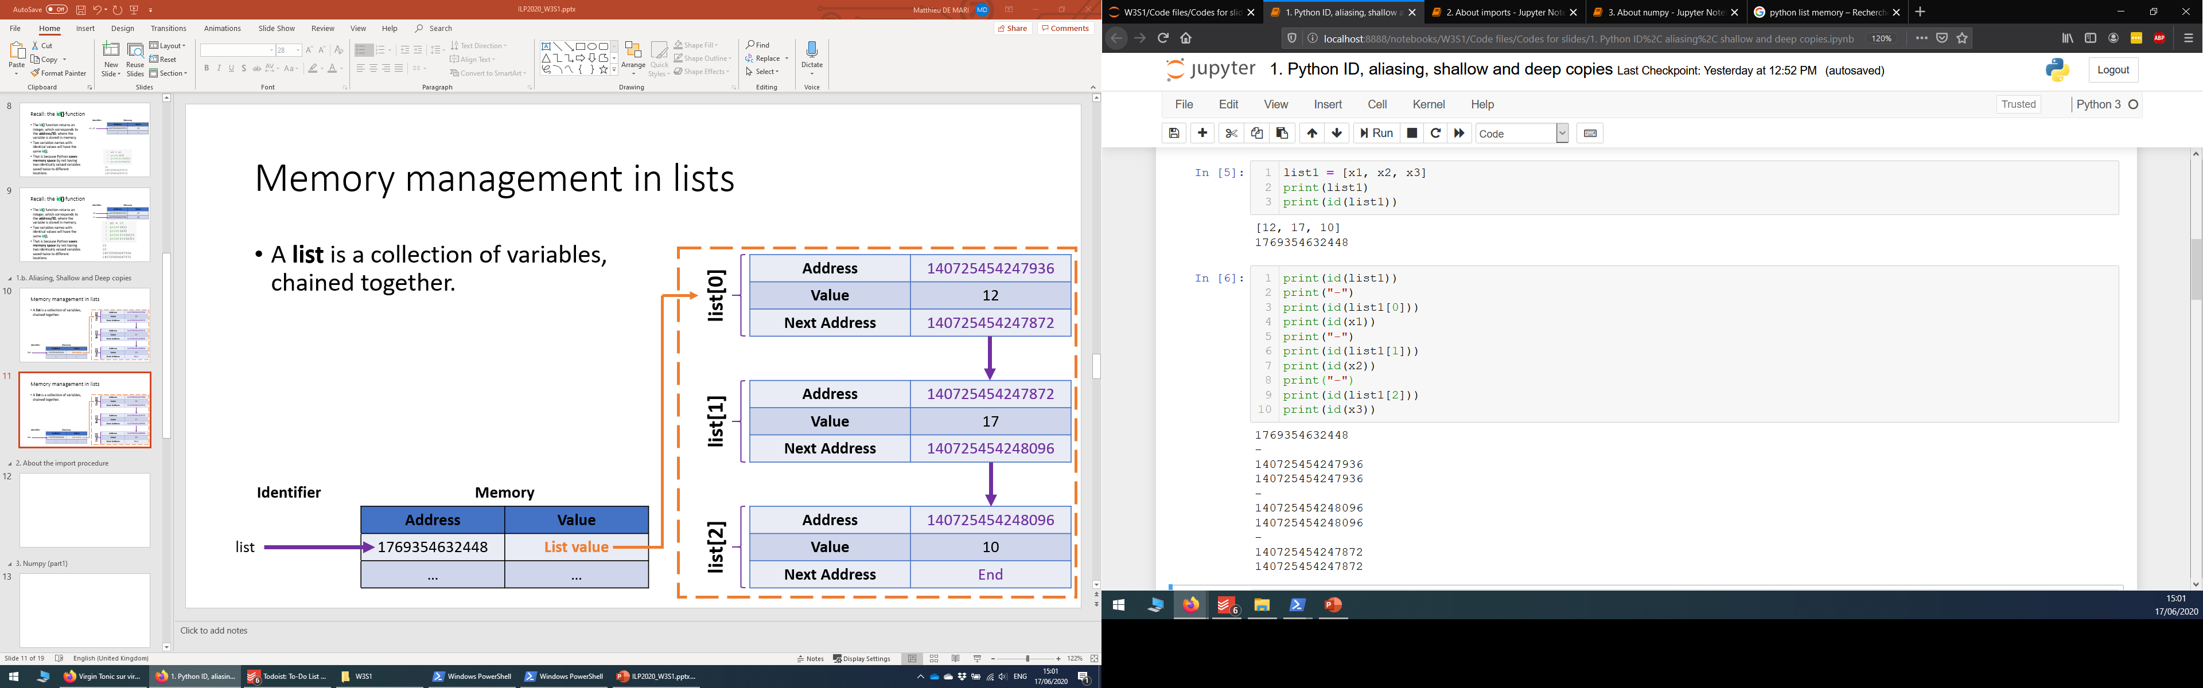
Memory management in lists
A list is a collection of variables.

Slide 11
Memory management in lists
A list is a collection of variables. The variables in a list are chained together.
Address | 140725454247936
Value | 12
Next Address | 140725454247872
list1[0]
Address | 140725454247872
Value | 17
Next Address | 140725454248096
list1[1]
Identifier | Memory
 | Address | Value
list1 | 1769354632448 | List value
 | … | …
Address | 140725454248096
Value | 10
Next Address | End of list
list1[2]

Slide 12
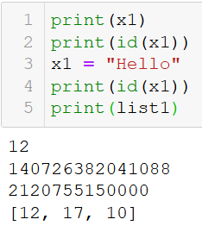
Memory management in lists
A list is a collection of variables. The variables in a list are chained together.
If x1 is changed, Python will adjust so that the list remains unaffected.
It simply reallocates x1 to another location in memory.

Slide 13
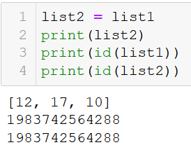
Aliasing in lists: problem
A list is a collection of variables. The variables in a list are chained together.
Aliasing: We can assign a list to another variable name.

Slide 14
Aliasing in lists: problem
A list is a collection of variables. The variables in a list are chained together.
Aliasing: We can assign a list to another variable name.
Address | 140725454247936
Value | 12
Next Address | 140725454247872
list1[0] list2[0]
Address | 140725454247872
Value | 17
Next Address | 140725454248096
list1[1]
list2[1]
Identifier | Memory
 | Address | Value
list1, list2 | 1769354632448 | List value
 | … | …
Address | 140725454248096
Value | 10
Next Address | End of list
list1[2]
list2[2]

Slide 15
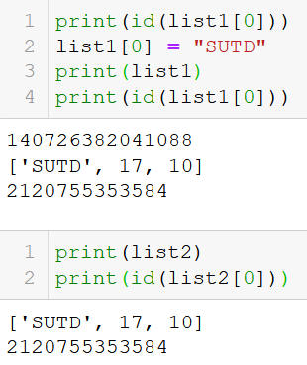
Aliasing in lists: problem
A list is a collection of variables. The variables in a list are chained together.
Aliasing: We can assign a list to another variable name.
Problem: changing list1[0] changes list1 values, but also changes list2.

Slide 16
Aliasing in lists: problem
A list is a collection of variables. The variables in a list are chained together.
Aliasing: We can assign a list to another variable name.
Problem: changing list1[0] changes list1 values, but also changes list2.
Address | 140725454247936
Value | 12 → “SUTD”
Next Address | 140725454247872
list1[0] list2[0]
Address | 140725454247872
Value | 17
Next Address | 140725454248096
list1[1]
list2[1]
Identifier | Memory
 | Address | Value
list1, list2 | 1769354632448 | List value
 | … | …
Address | 140725454248096
Value | 10
Next Address | End of list
list1[2]
list2[2]

Slide 17
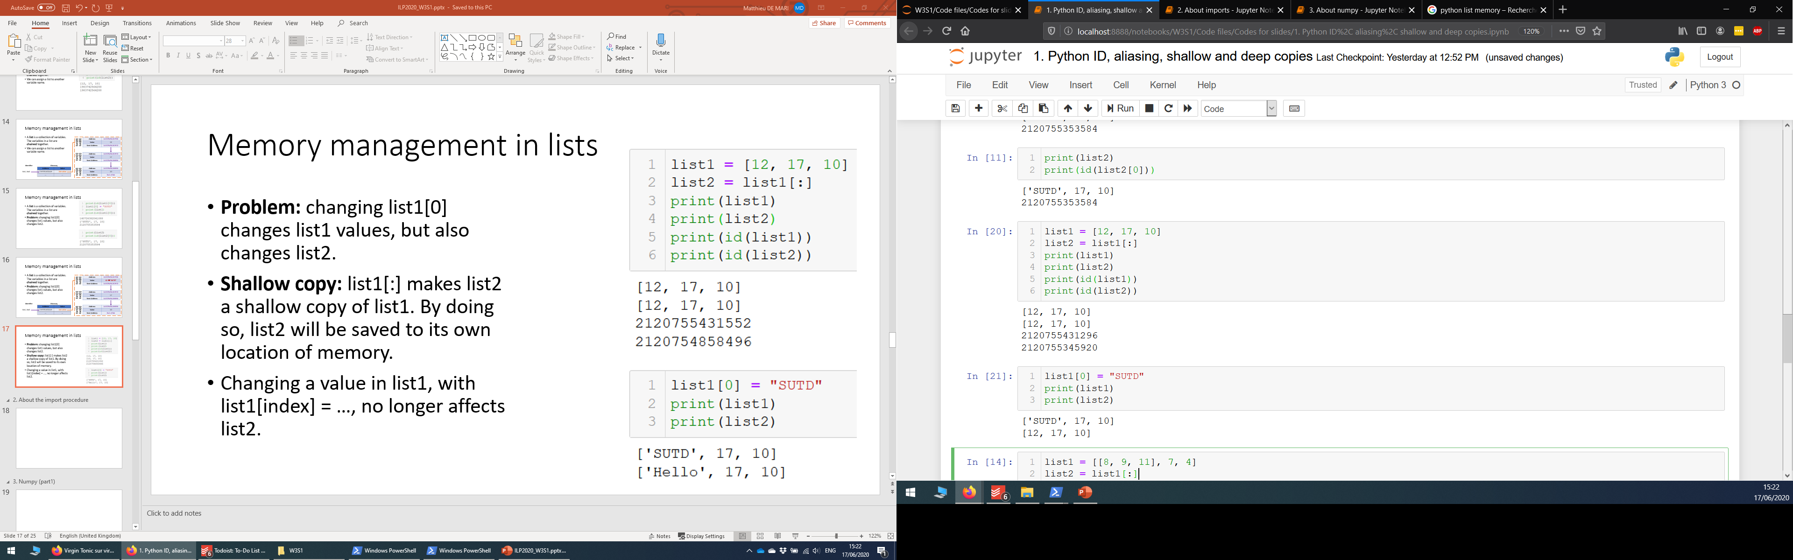
Shallow copy of a list
Problem: changing list1[0] changes list1 values, but also changes list2.
Shallow copy: list1[:] makes list2 a shallow copy of list1. By doing so, list2 will be saved to its own location of memory.

Slide 18
Shallow copy of a list
Problem: changing list1[0] changes list1 values, but also changes list2.
Shallow copy: list1[:] makes list2 a shallow copy of list1. By doing so, list2 will be saved to its own location of memory.
Changing a value in list1, with list1[index] = …, no longer affects list2.
Note: you can also use the copy() method.

Slide 19
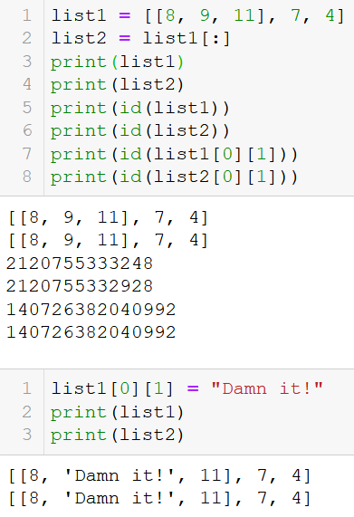
Shallow copy: problem
Note: if an element of a list is a list (case of lists of lists), then the shallow copy will not copy the sublists to different locations of memory.
Problem: changing a sublist element then affects both lists, even though these lists are shallow copies of each other.

Slide 20
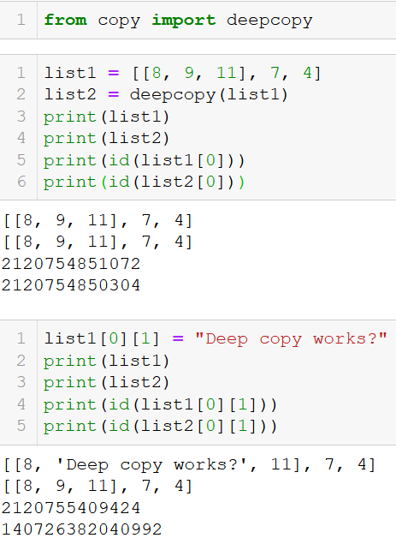
Deep copy
Solution: make a deep copy, using the Python built-in copy library.
A deep copy forces Python to make sure all elements and sub-elements are assigned to different locations in memory.

Slide 21

Matt’s Great advice #10
Matt’s Great Advice #10: Keep the aliasing, shallow and deep copies concepts in mind for now.
If you find that modifying a list object ends up unexpectedly changing another, then you might have an aliasing or shallow copy problem.
When in doubt, make a deep copy.
For now, do not worry about understanding all these memory concepts, these will be covered in another advanced course!

Slide 22

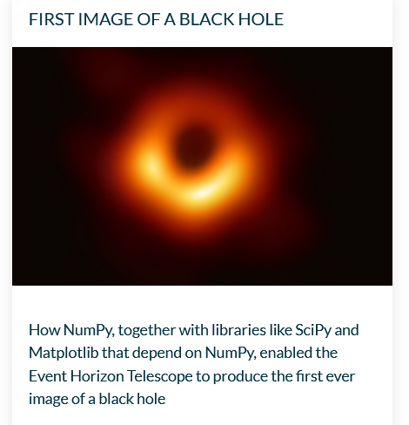
About the numpy library
Numpy is one of the most common (if not the most popular) libraries in Python.
Used for many applications: computing, modelling, data science, astrophysics, etc.
Linear algebra (one of the main concepts of math with many applications in computing)

Slide 23
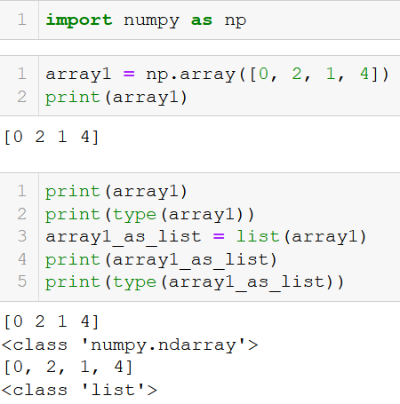
A new type of objects: Numpy Arrays
Numpy arrays are objects from the Numpy library.
Typically used to describe matrices and vectors,
Or tables of data.
The look very similar to (nested lists of) lists, which we have used earlier for many applications.
The Numpy library, however, comes with many additional functions and methods.

Slide 24
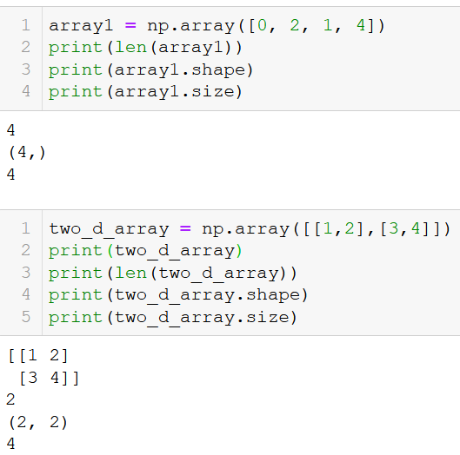
Length, size, shape
Just like lists, the Numpy arrays have a length, which can be checked with len().
The also have a shape and a size attribute, which give additional information, in the case of arrays with more than 1D.
Attribute: “sub-variable” of an object; applies to an object using the . operator. (Object-oriented concept, not covered yet)

Slide 25
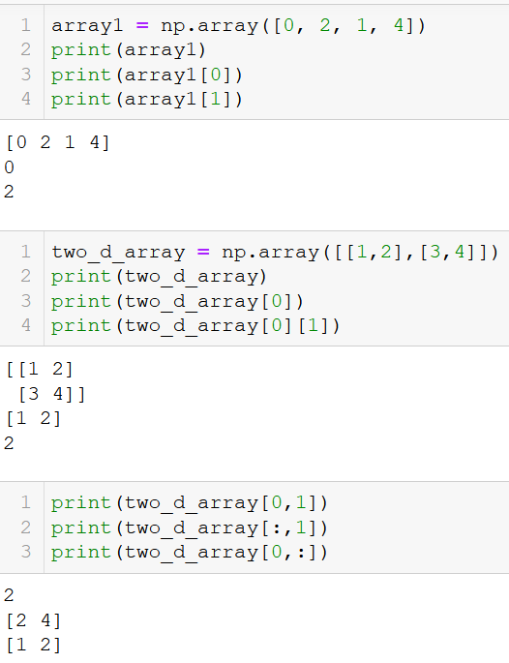
Indexing an array
Just like lists, the Numpy arrays are indexed and their element can be accessed with [].
You can equivalently use the [i,j] and [i][j] notations on arrays.
Replacing an index with a colon symbol :, means “take all”.
For instance, [:, j] means all elements in column j, whereas [i, :] means all elements in row i.

Slide 26
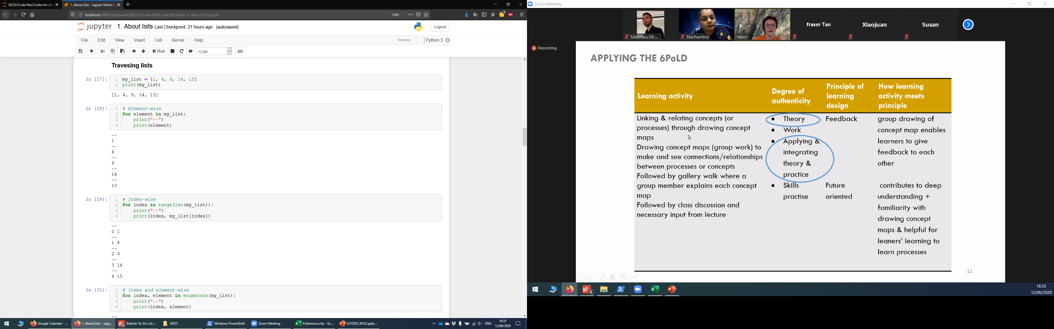
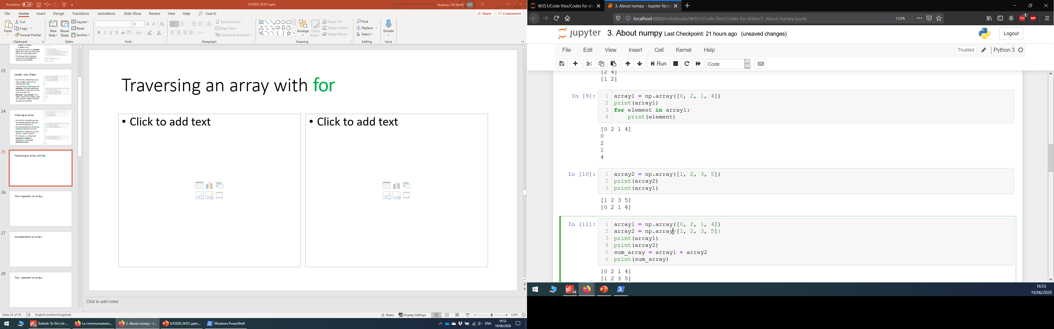
Traversing an array with for
As with lists, we can traverse a Numpy array, in an element-wise manner, using a for loop.

Slide 27
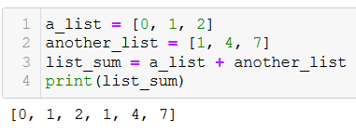
The + operator on arrays
The + operator on lists: On lists, the + operator will concatenate both lists into a new one.

Slide 28
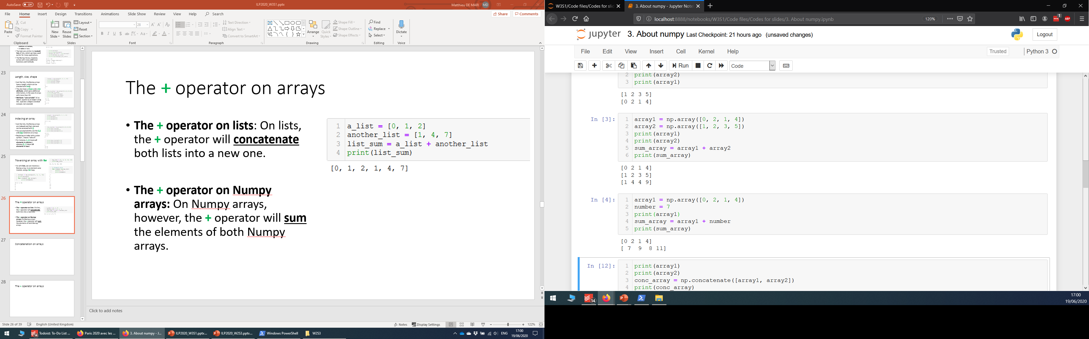
The + operator on arrays
The + operator on lists: On lists, the + operator will concatenate both lists into a new one.
The + operator on Numpy arrays – (vector sum): On Numpy arrays, however, the + operator will sum the elements of both Numpy arrays.

Slide 29
The + operator on arrays
The + operator on lists: On lists, the + operator will concatenate both lists into a new one.
The + operator on Numpy arrays – (vector sum): On Numpy arrays, however, the + operator will sum the elements of both Numpy arrays.
Broadcasting: If summed with a number instead, the elements in the Numpy array will each be incremented by the given value.

Slide 30
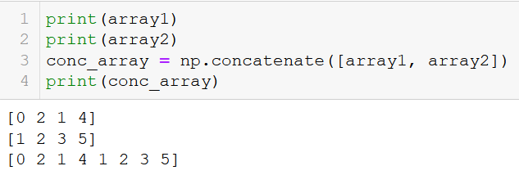
Concatenation on arrays
Since the + operator cannot be used for concatenation, Numpy comes with a concatenate() function.

Slide 31
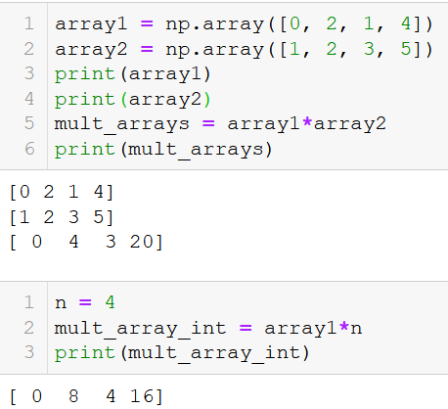
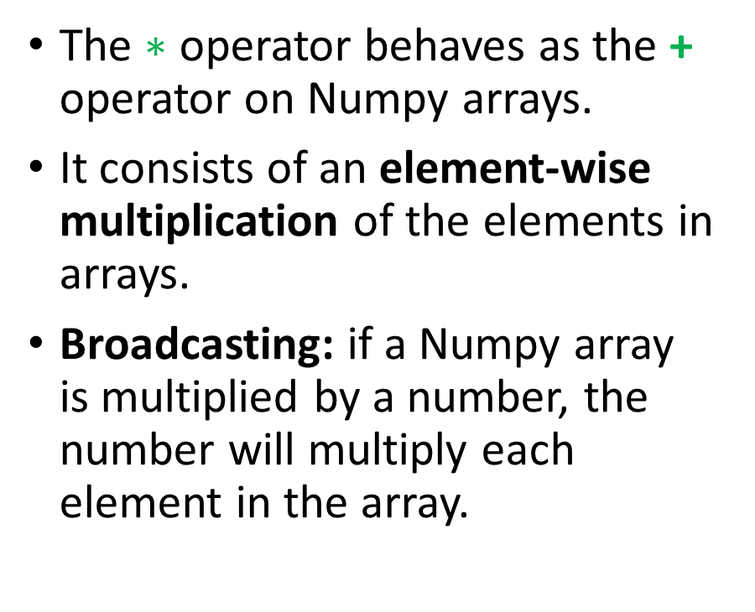

The $∗$ operator on arrays
The $∗$ operator behaves as the + operator on Numpy arrays.
It consists of an element-wise multiplication of the elements in arrays.
Broadcasting: if a Numpy array is multiplied by a number, the number will multiply each element in the array.

Slide 32
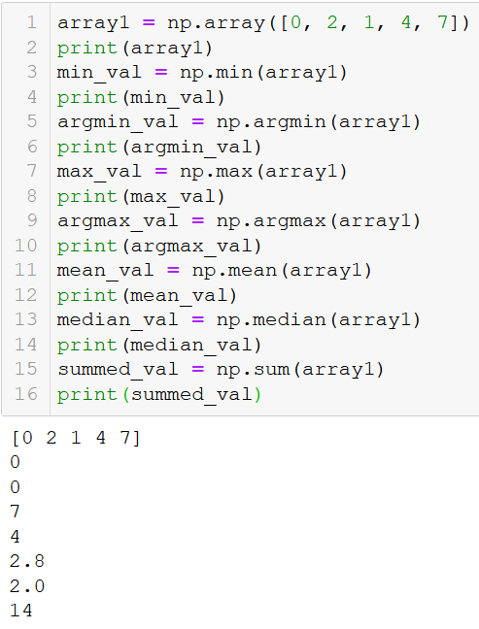
Additional functions
Additional Numpy functions
Min, max: returns the minimal, resp. maximal, values in array.
Argmin, argmax: returns the index where the minimal, resp. maximal, values are.
Mean, median: returns the mean, resp. median, value for a given array.
Sum: sums all the elements in the array together

Slide 33
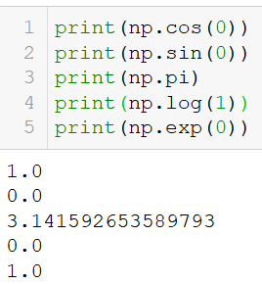
Mathematical functions and constants
Numpy also contains
Many mathematical functions (cosine, sine, logarithm, exponential, etc.)
And many mathematical constants (pi, etc.)

Slide 34
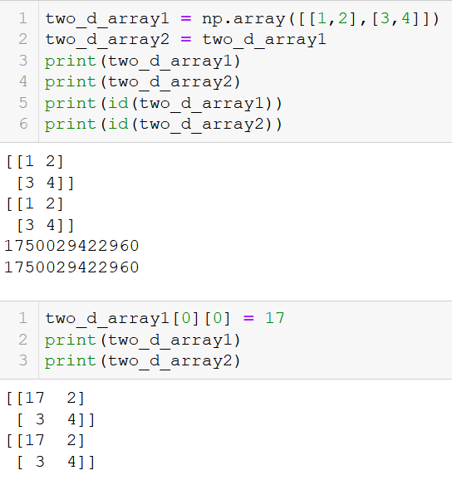
Aliasing, Shallow and Deep copies in arrays
As with lists, Numpy arrays are subject to the same issues about aliasing, shallow and deep copies.
If needed, use deep copies of the arrays.

Slide 35
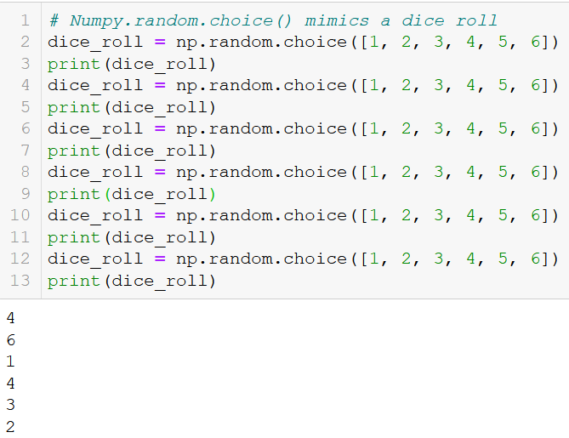
And so much more! RTFM!
Numpy has many more functions and tools to offer!
Random functions (to be covered in an upcoming session, if time allows?)
Learn more about Numpy (RTFM!) here:
https://numpy.org/doc/stable/

Slide 36
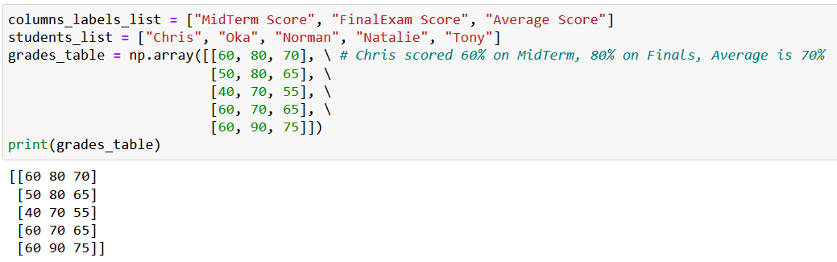
Activity 1 - Exam adjustments
Let us assume, that I have grades from my students listed in some np.array variables, as shown below.

Slide 37
Activity 1 - Exam adjustments
Let us assume, that I have grades from my students listed in a np.array.
The first line contains the column labels (student name, some scores) and the other lines will consist of entries regarding some of the students.
Let us assume that, as a professor, I have decided to be lenient towards my students.
I realized that the midterm was a bit too difficult compared to last year.
To compensate for that, I would like to increase the scores of all students on the midterm by 50%.

Slide 38
Activity 1 - Exam adjustments
Write a function grade_adjustment(),
which receives a grades table, grades_table,
increases the scores of all students on the midterm by 50%,
re-calculates the average score, with the new adjusted midterm score,
and then returns the updated grades table as its sole output.

Slide 39
Activity 1 - Exam adjustments
Write a function grade_adjustment(),
which receives a grades table, grades_table,
increases the scores of all students on the midterm by 50%,
re-calculates the average score, with the new adjusted midterm score,
and then returns the updated grades table as its sole output.
Important note: The maximal score for the midterm exam is capped to 100. This means that a student which scores 80 points on the midterm, will not obtain 120 points after the adjustment, but only 100.

Slide 40
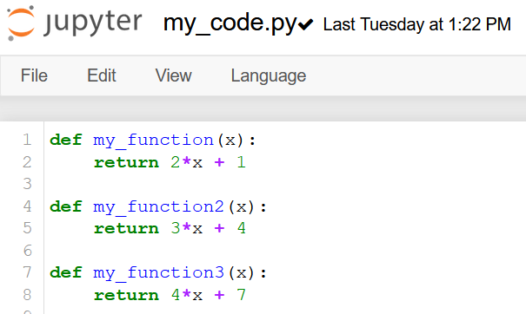
The import procedure
my_code.py file
The import procedure is used to import functions defined in external .py files.

Slide 41
The import procedure
my_code.py file
The import procedure is used to import functions defined in external .py files.
To demonstrate, we have defined a my_code.py file with three functions.

Slide 42
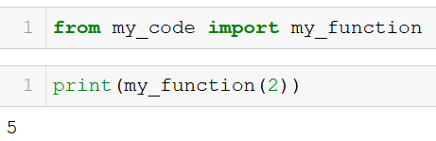
The import procedure
my_code.py file
The import procedure is used to import functions defined in external .py files.
To demonstrate, we have defined a my_code.py file with three functions.
We can then import one of these functions in our Notebook, by using the from … import … command.
In our notebook

Slide 43
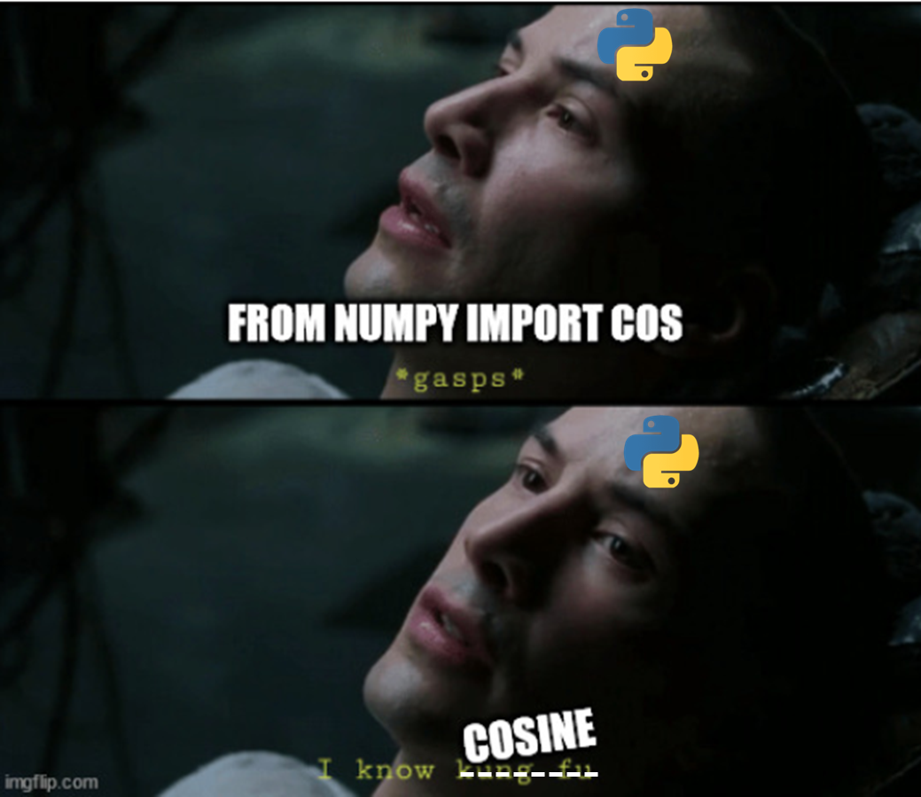


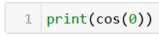
The import procedure
Operator: Cosine function coming right up!

Slide 44
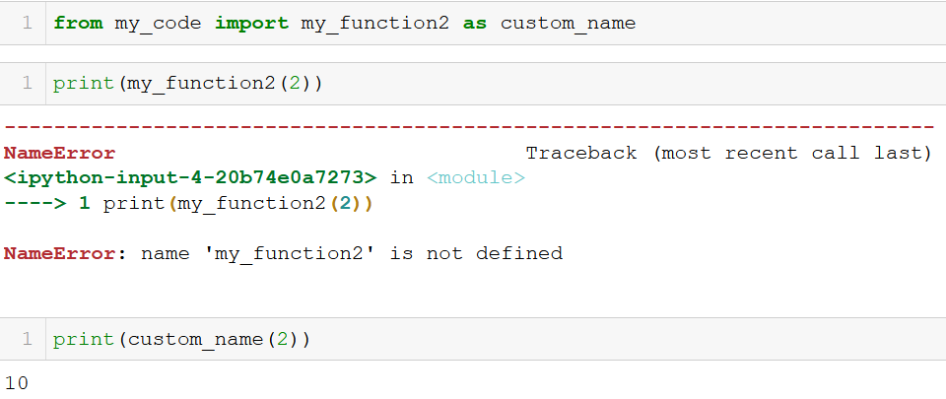
Importing as
my_code.py file
If needed, we can import and rename a function by using the as keyword.
The whole command then reads from … import … as …
Note: if you rename the function, its calling name changes to the alias you specified.
In our notebook

Slide 45
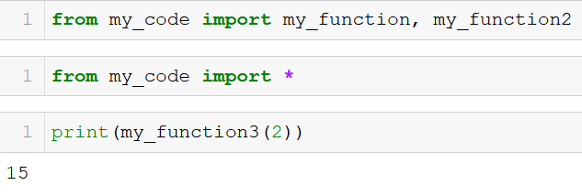
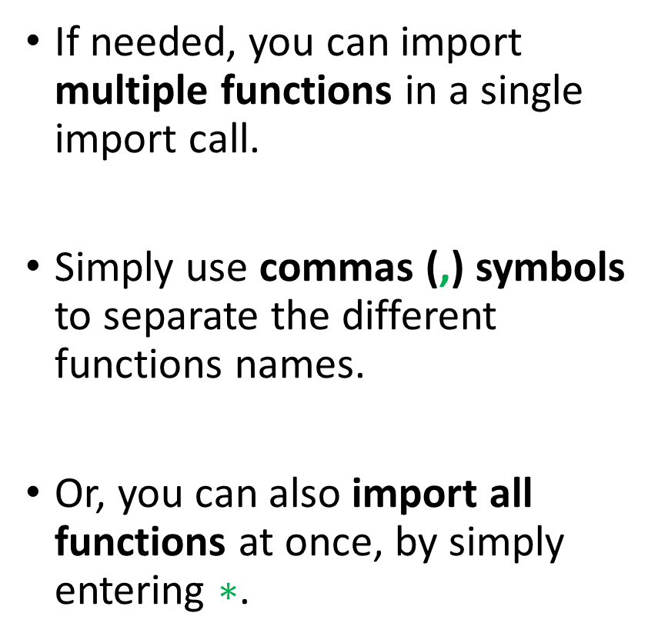
Importing several functions
my_code.py file
If needed, you can import multiple functions in a single import call.
Simply use commas (,) symbols to separate the different functions names.
Or, you can also import all functions at once, by simply entering $∗$.
In our notebook

Slide 46
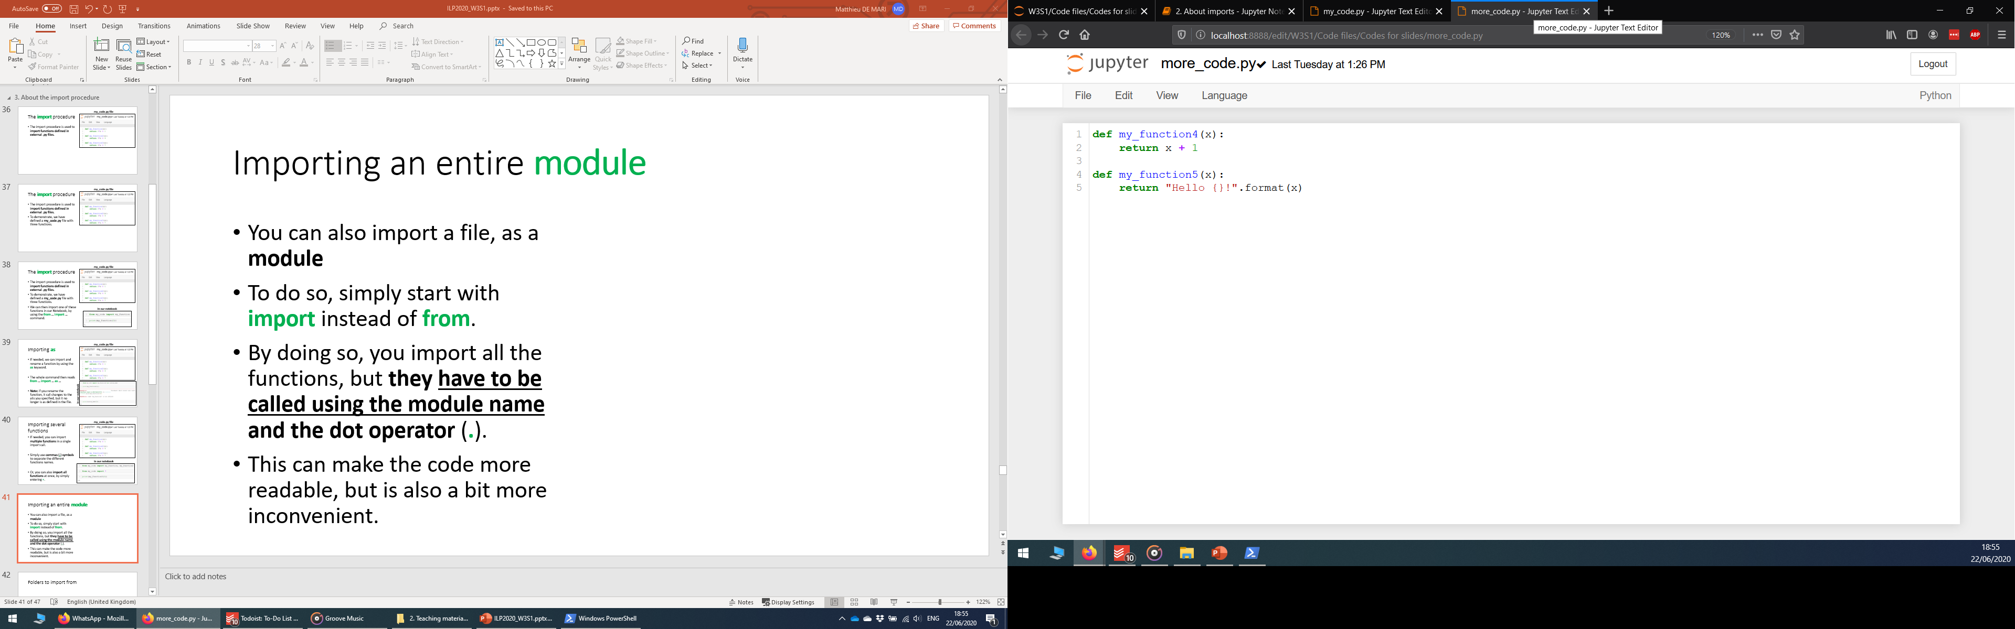
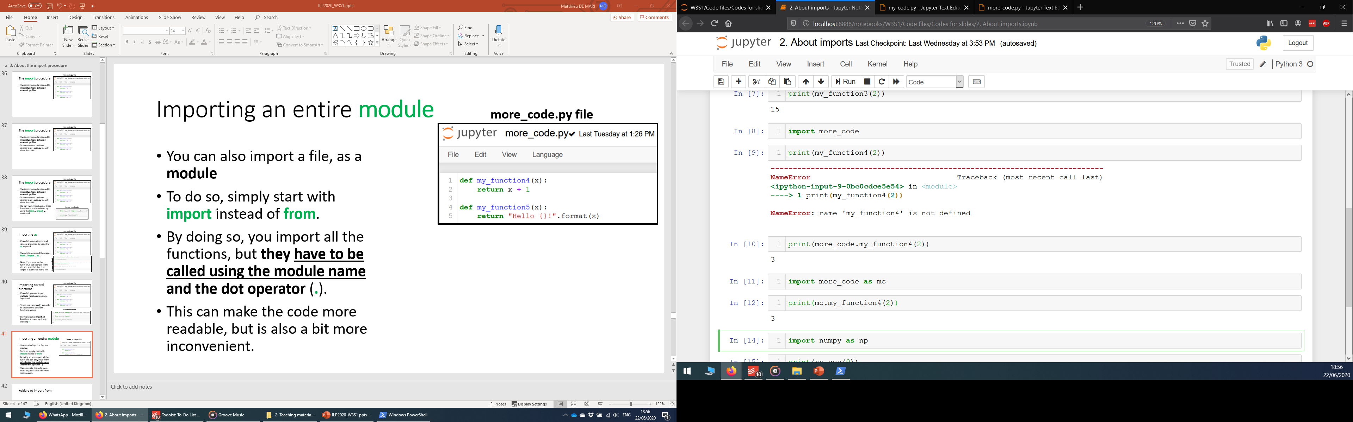
Importing an entire module
more_code.py file
You can also import a whole file, as a module.
To do so, simply start with import instead of from.
By doing so, you import all the functions, but they have to be called using the module name and the dot operator (.).
This can make the code more readable, but is also a bit more inconvenient.
In our notebook

Slide 47
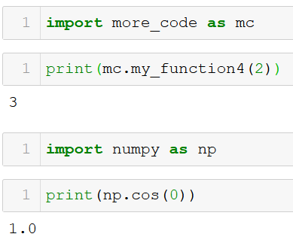
Importing an entire module
more_code.py file
You can also use an alias for the module using the as keyword, as before.
Typically, we often do it with Numpy! import numpy as np
In our notebook

Slide 48
Folders to import from
Observation: Python imported functions from my_code.py, which was located in the same folder as my Notebook.
But there was no numpy.py file in this location.
What happened?

Slide 49
Folders to import from
Observation: Python imported functions from my_code.py, which was located in the same folder as my Notebook.
But there was no numpy.py file in this location.
What happened?
Python looks for files in your current folder first,
and then looks in your Python installation directory.

Slide 50
Folders to import from
Observation: Python imported functions from my_code.py, which was located in the same folder as my Notebook.
But there was no numpy.py file in this location.
What happened?
Python looks for files in your current folder first,
and then looks in your Python installation directory.
When you installed the Numpy package with pip on Week 1, you downloaded some numpy files and stored them in your Python installation folder!

Slide 51
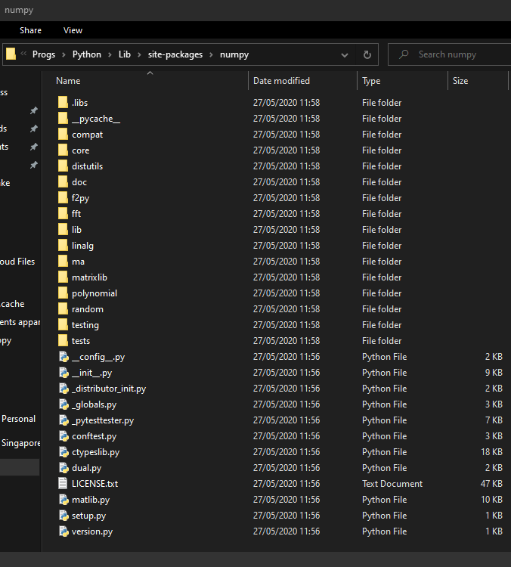
Folders to import from
Python looks for files in your current folder first,
and then looks in your Python installation directory.
When you installed the Numpy package with pip on Week 1, you downloaded some numpy files and stored them in your Python installation folder!

Slide 52
Project organizing
In many projects, several developers will often collaborate on a single project.
And each one of them will end up working on a single aspect of the project.

Slide 53
Project organizing
In many projects, several developers will often collaborate on a single project.
And each one of them will end up working on a single aspect of the project.
E.g. in a video game:
One developer can design the main character,
Another one will develop enemies,
Another one will develop items and weapons,
Another one will design the map/environment in which heroes and enemies evolve,
Etc.

Slide 54
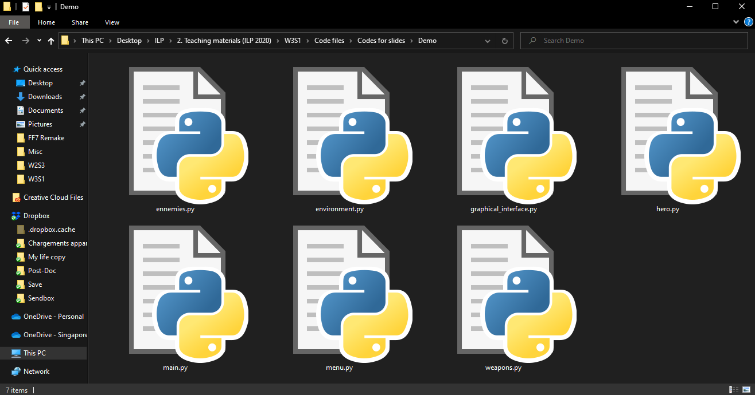

Slide 55
Project organizing
Each developer will then work on his/her own .py file, taking care of his/her specific subtask.
Later on, other developers might import functions from files created by other people.
Eventually assemble all pieces in a main.py file!

Slide 56
Project organizing
Each developer will then work on his/her own .py file, taking care of his/her specific subtask.
Later on, other developers might import functions from files created by other people.
Eventually assemble all pieces in a main.py file!
This is something very common in programming projects.
Important: you need to build the habit of documenting your functions!

Slide 57
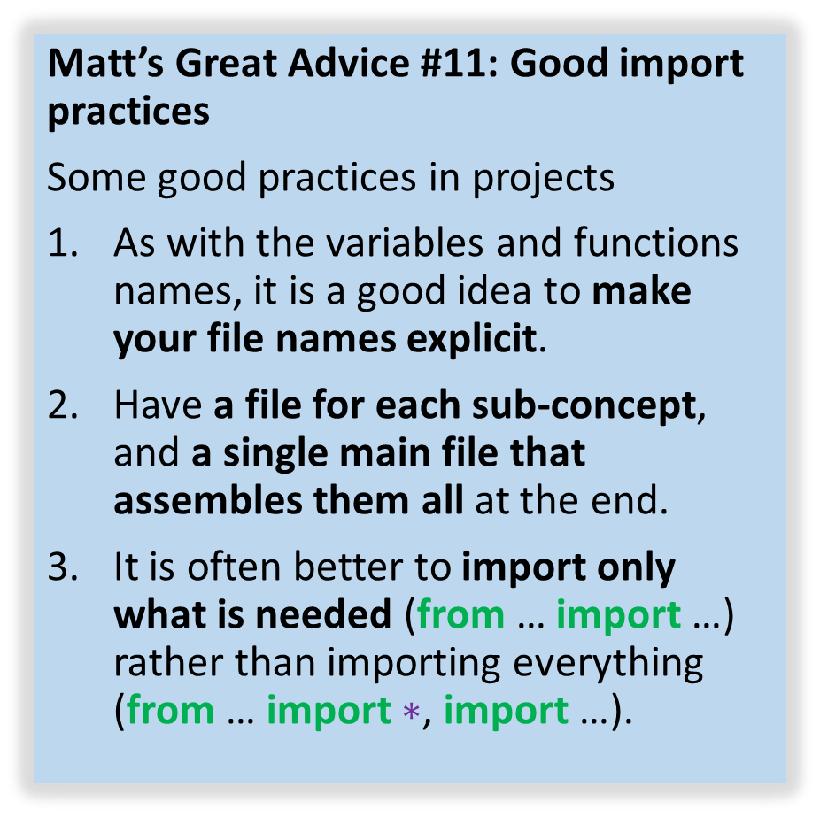
Matt’s Great advice #11
Matt’s Great Advice #11: Good import practices
Some good practices in projects
As with the variables and functions names, it is a good idea to make your file names explicit.
Have a file for each sub-concept, and a single main file that assembles them all at the end.
It is often better to import only what is needed (from … import …) rather than importing everything (from … import $∗$, import …).

Slide 58
Conclusion
Memory management and lists: aliasing, shallow and deep copies
The Numpy library (part 1): arrays, math functions, etc.
About the import procedure
Project organizing
Mini-project

